Slide 1
PDCB BioC for HTS topic Understanding the tech. 02
LCG Leonardo Collado Torres
lcollado@wintergenomic.com lcollado@ibt.unam.mx
September 2nd, 2010

Slide 2
Topics
Basecalling
Quality Filtering
FASTQ format
Error rates
A gamma of problems / reports
Fragment of James Huntley’s ppt on best practices

Slide 3
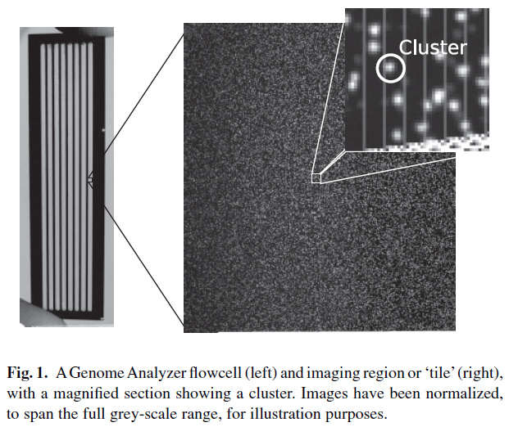
Basecalling: Illumina

Slide 4
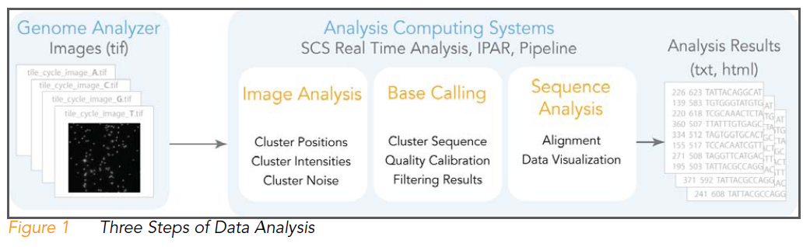

Slide 5


Slide 6
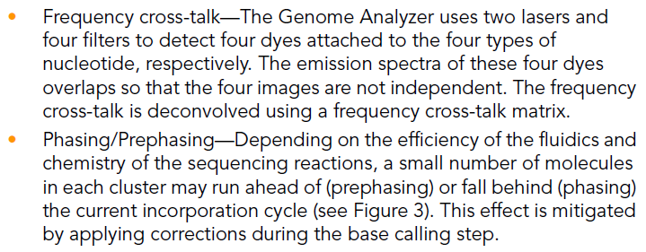

Slide 7
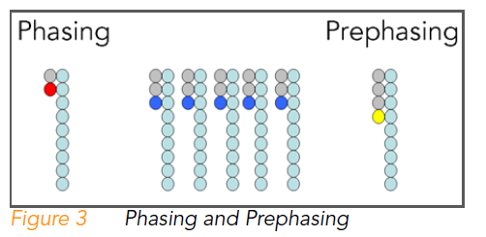

Slide 8
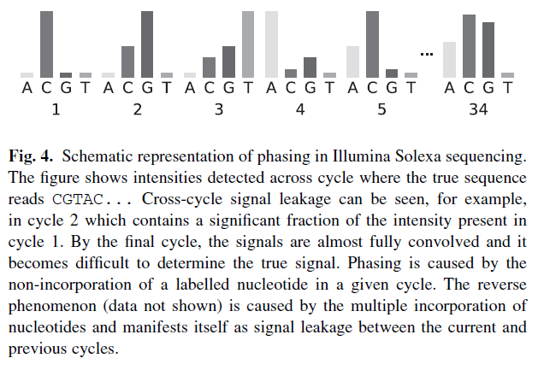

Slide 9
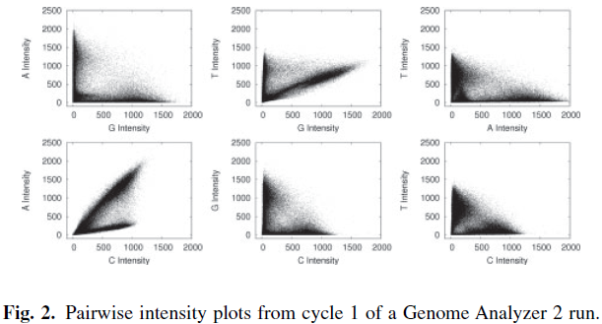
Cross-talk

Slide 10
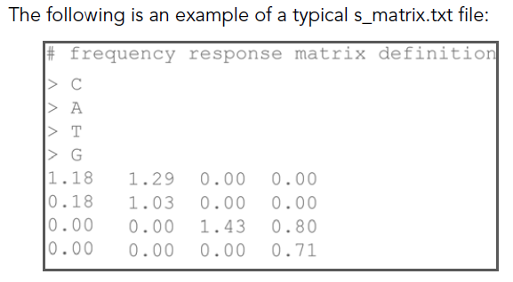

Slide 11
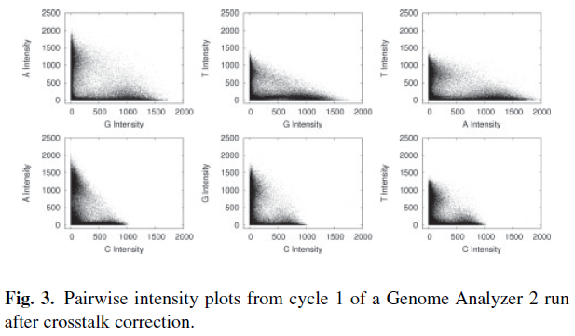
SWIFT: cross-talk correction

Slide 12
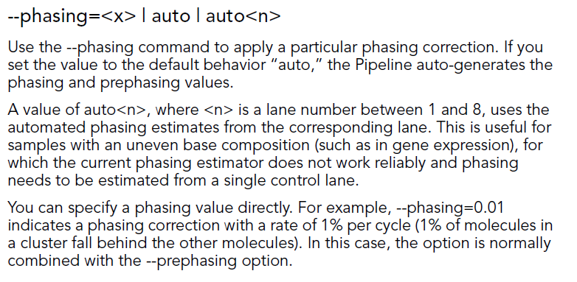
Phasing and Prephasing options

Slide 13
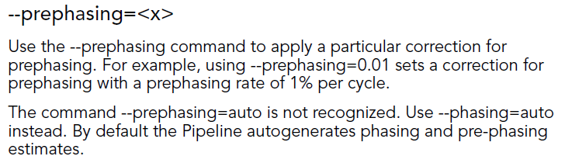

Slide 14
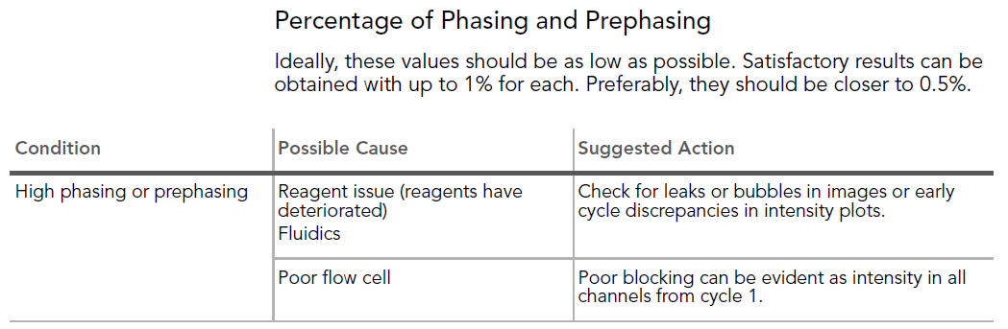

Slide 15
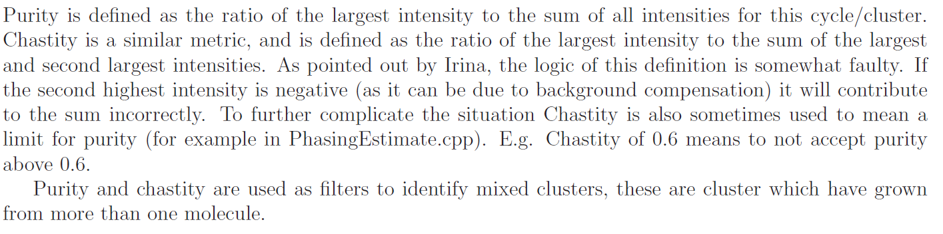
Some warnings!

Slide 16
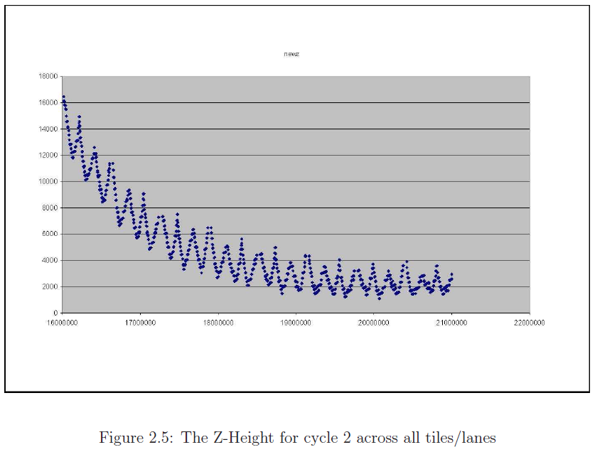
Notes:
Slope
Heat by base incorporation vs ambient temp

Slide 17
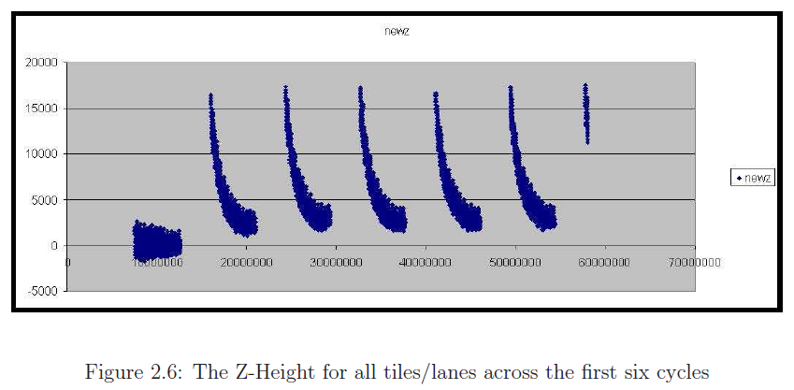

Slide 18
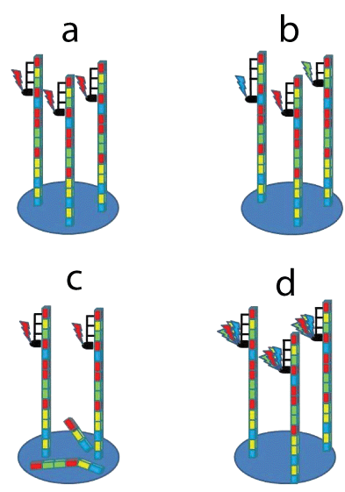
Describe each case

Slide 19
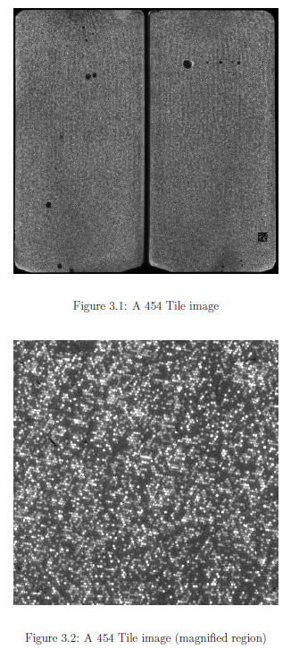

Slide 20
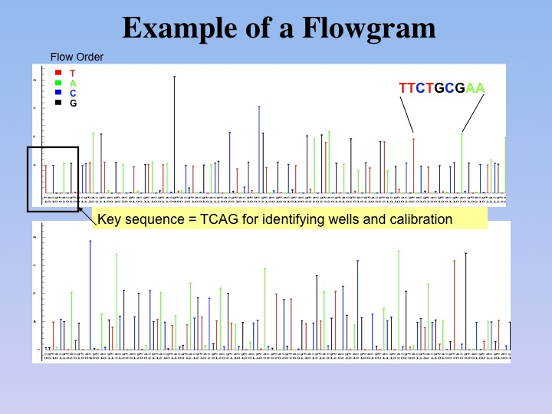

Slide 21
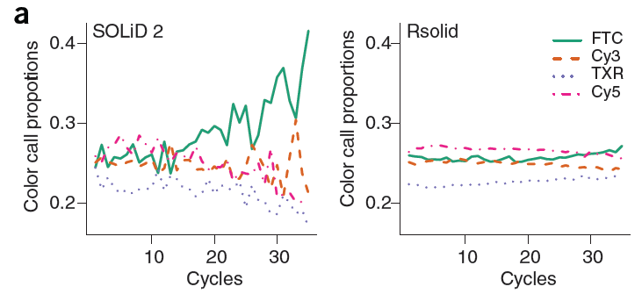

Slide 22
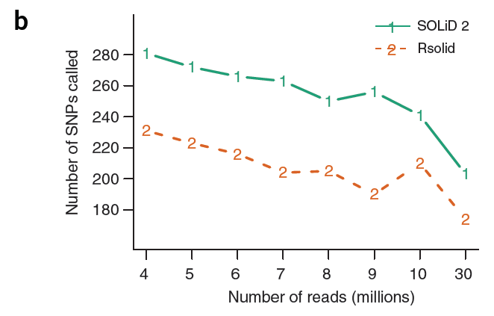

Slide 24
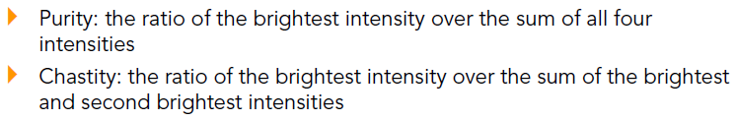
Quality Filtering: Purity and Chastity

Slide 25
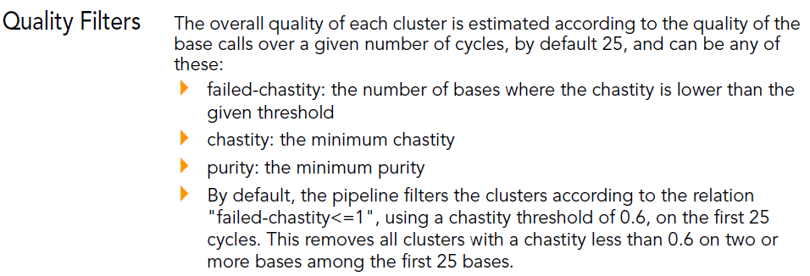

Slide 27
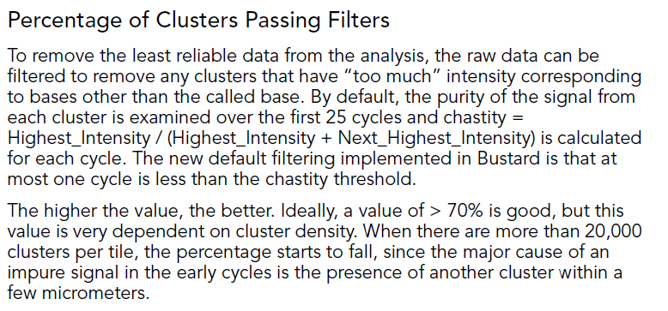
What artifact can be derived from this step?

Slide 28
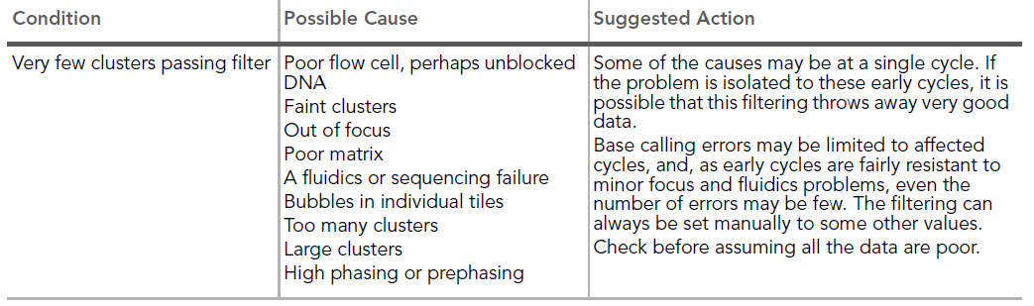

Slide 30
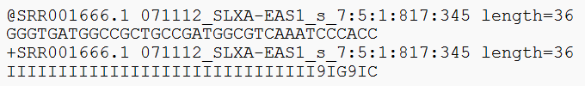
FASTQ format
@ is the seq id
sequence
+ is the qual id
Quality in ASCII chars

Slide 31
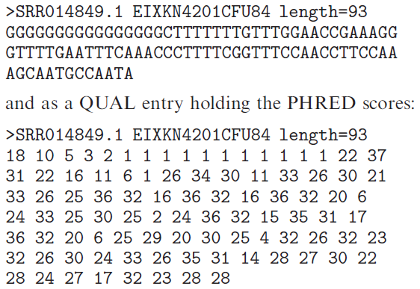
Originally…

Slide 32

Q to error probability (p) formulas
Qphred
Qsolexa1.3

Slide 33
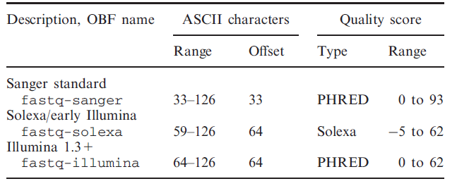
FASTQ types
What is the quickest way to distinguish fastq-sanger from fastq-illumina?
Tip: Check the ASCII table ☺

Slide 34
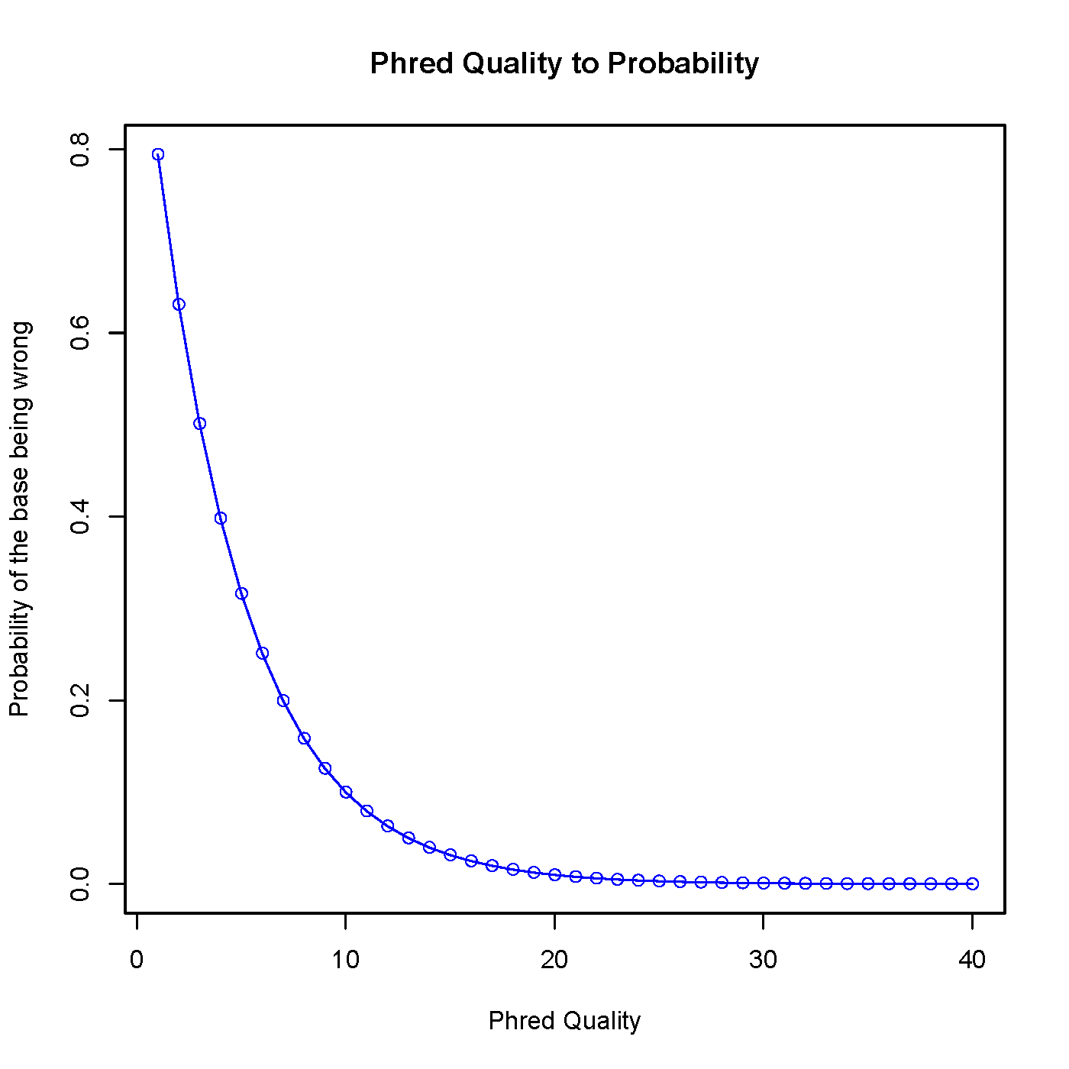
phred.R

Slide 35
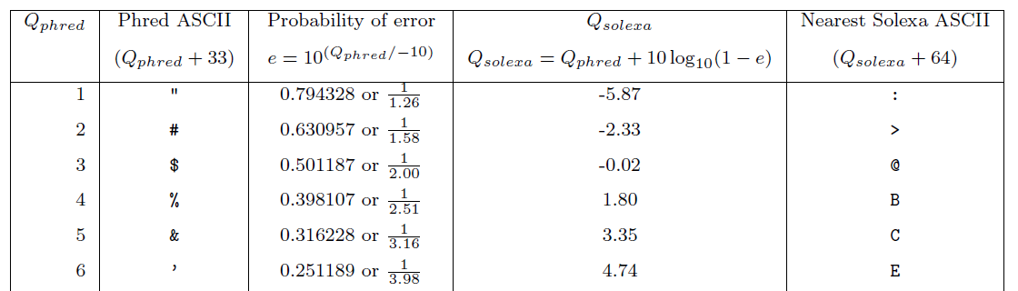
It is NOT clear what quals of 1 and 2 mean in Illumina (version 1.5+)

Slide 36
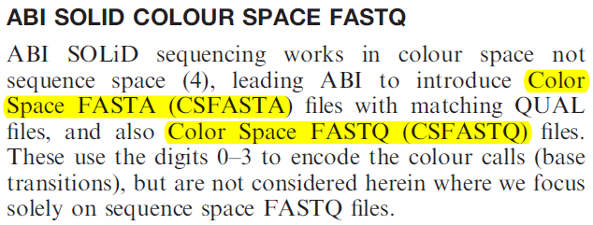
FASTQ in CS
Base 1 does not include a quality value! (It’s a 0)

Slide 38
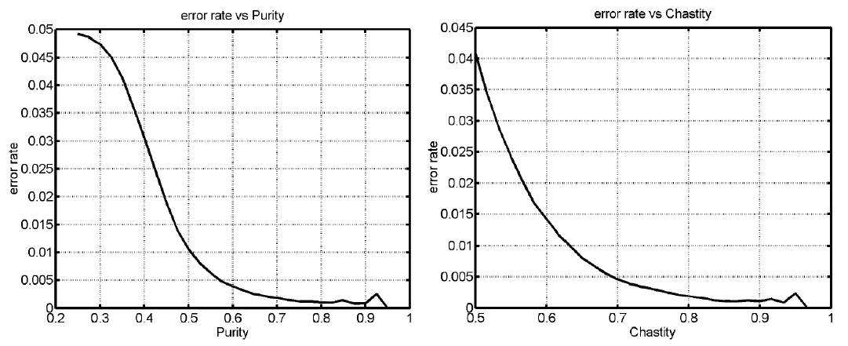
Error rates

Slide 39
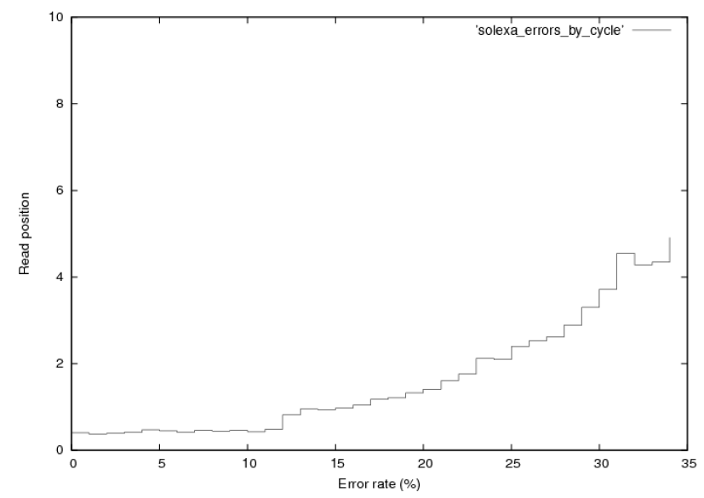
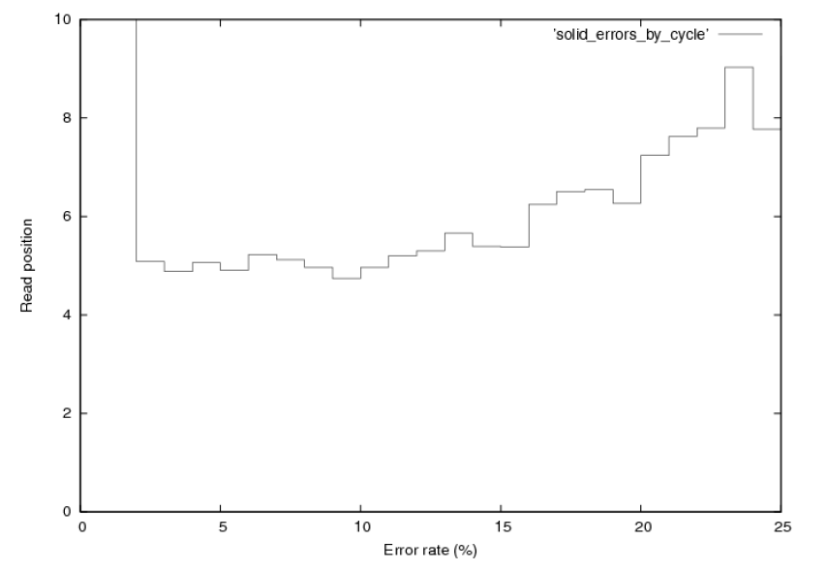
Illumina vs SOLiD: % per cycle

Slide 40
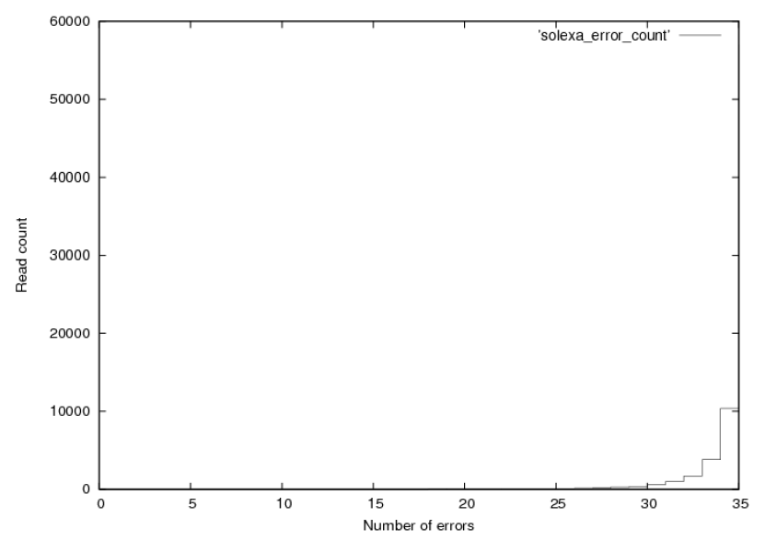
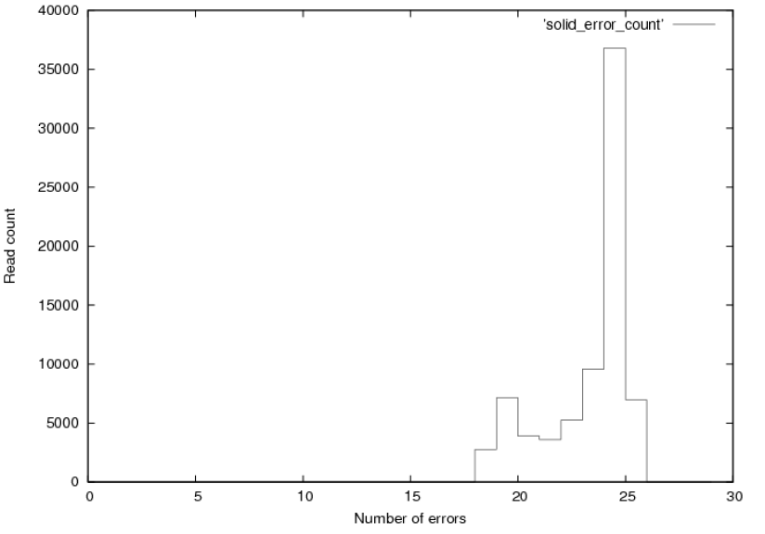
Illumina vs SOLiD: num of errs

Slide 41
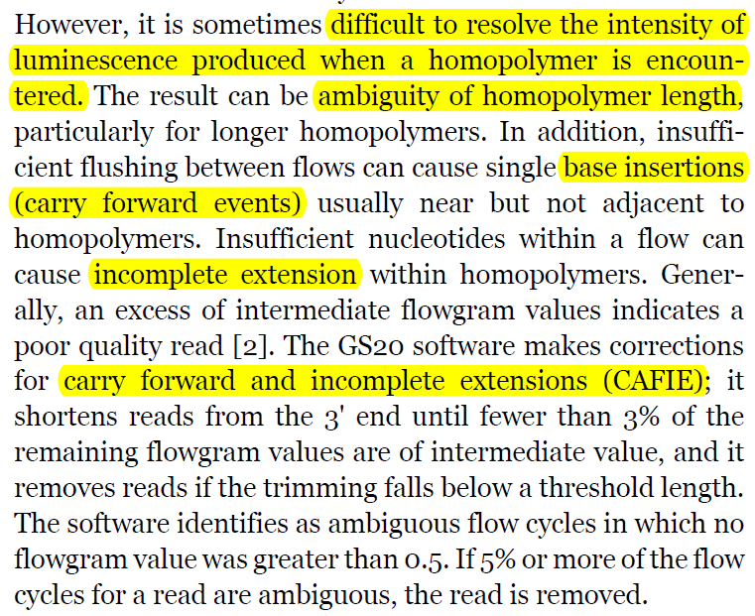
Understanding 454 (GS20) a bit more

Slide 42
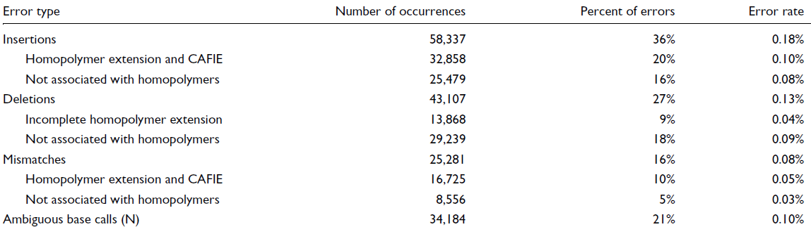
454 error types

Slide 43
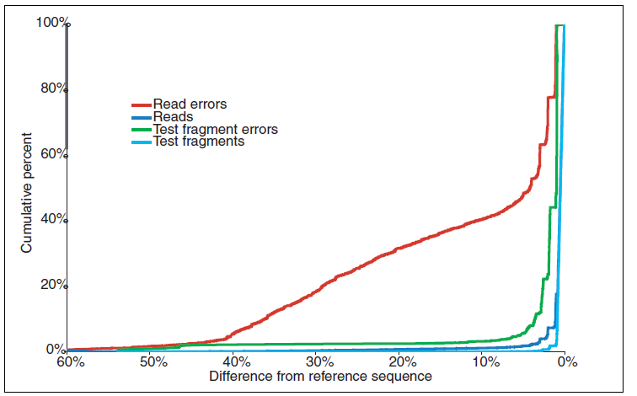
454 errors

Slide 44
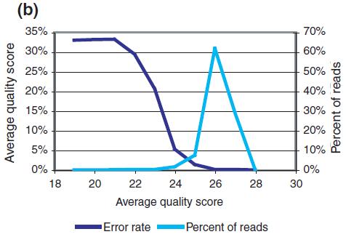

Slide 45
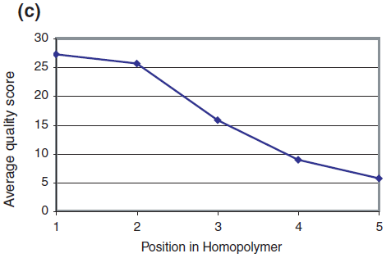
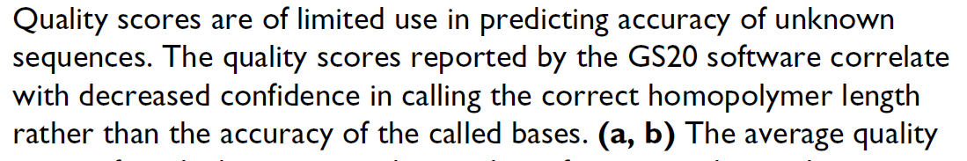

Slide 46
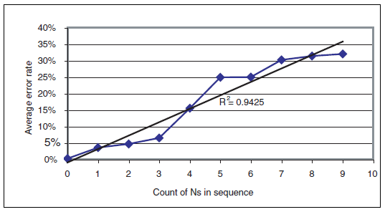
Presence of Ns correlates with error rate (454)

Slide 47
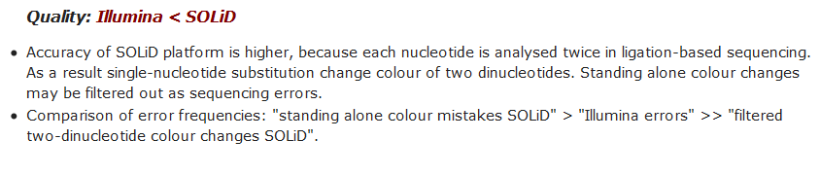
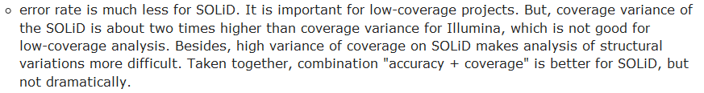
Illumina vs SOLiD

Slide 48
Helicos

Slide 50
A gamma of problems / reports
Aligned to the wrong reference
Did not use the correct quality encoding
Barcodes are trimmed or have mismatches
Trimming the 1st and last base → losing barcodes
GC bias
Sample degradation will affect your data!

Slide 51
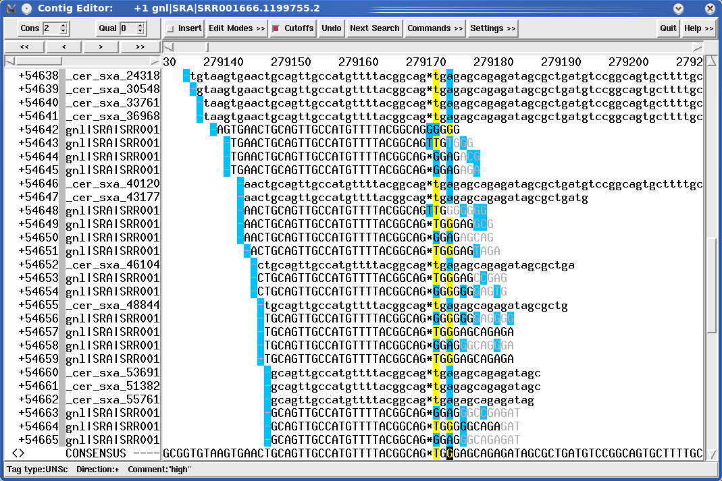
What is wrong here?

Slide 52
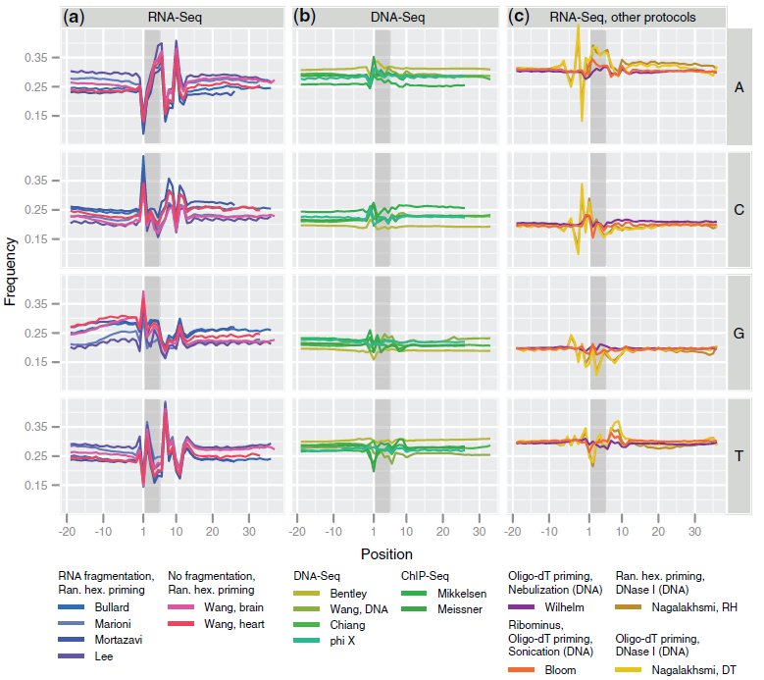
Random primers

Slide 53
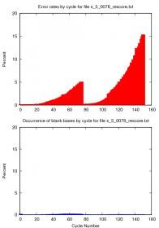
Quality drop off on the 2nd pair

Slide 54
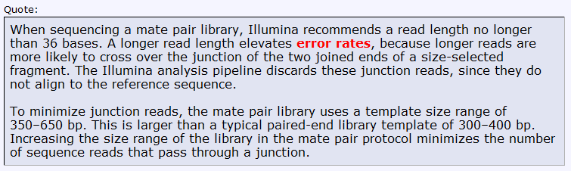
Mate Pair libraries

Slide 55
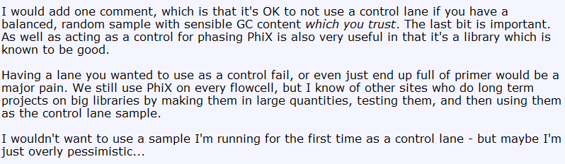
Can I stop using the control lane?

Slide 56
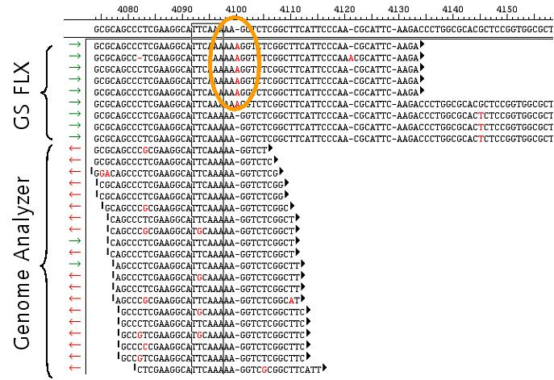
Hybrid 454 / Illumina

Slide 57
Overlap read ends to increase qual

Slide 58
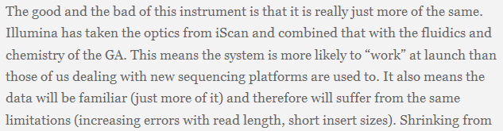
HiSeq

Slide 59


Slide 60

QC steps by a lab with the HiSeq

Slide 61
“Many, many dumb newbie questions”
http://seqanswers.com/forums/showthread.php?t=1658
Definitely helpful ☺

Slide 63
Fragment of James Huntley’s ppt on best practices

Slide 64
Some interesting things you might see
Undulating coverage across a reference sequence
3’-bias for a mRNA-seq library
BA trace for an over-amplified library
Single- and bimodal distribution of read coverage for short- and long-insert PE libraries
Base sequence bias for the first few cycles in a mRNA-seq sequencing run
Excessive adapter contamination in library
Completely failed library: what does that look like when clustering/sequencing?

Slide 65



Undulating coverage across a reference sequence
no fragmentation
fragmentation
H1N1 vRNA sequencing libraries

Slide 66
3’-bias for a mRNA-seq library
Histogram showing coverage along an ‘‘averaged’’ reference transcript for 1.2 Gb of cerebellar cortex cDNA sequences. ‘‘Short transcripts’’ are all transcripts of <500 bp to which reads were aligned. ‘‘Long transcripts’’ are all transcripts >10 kb to which reads were aligned. Numbers in parentheses are the number of transcripts represented by each category. Mudge et al., 2008, PLoS One.

Slide 67

Bioanalyzer trace for an over-amplified library

Slide 68


Library Evaluation (Phenotypes- Over-amplified library)
Increasing Template
1x
1.5x
2x
Increasing
Cycles
10
12
14
16
18
Courtesy Keith Moon

Slide 69


Base sequence bias for the first few cycles in a mRNA-seq sequencing run

Slide 70


Excessive adapter contamination in library

Slide 71
List of common reasons why sample prep fails
Poor input sample quality/quantity
Sample loss, poor laboratory technique
Using the wash buffer (PE) rather than the elution buffer (EB) when eluting the final library off the QIAquick columns
Insufficient resuspension of the SeraMag beads
Using the wash buffer instead of the binding buffer when preparing/washing the SeraMag beads
RNA sticking to surface of microfuge tubes
Excessive degradation (thermal and enzymatic)
Using the wrong heat block(s)
Not spinning down the QIAquick column enough to adequately remove all residual EtOH prior to loading on the size-selection agarose gel (library blows out of well)
Preparing the wrong concentration of agarose in the size selection gel (leads to grabbing the wrong band)
The list goes on!

Slide 73
References
James Huntley’s “Sequencing Sample Prep Best Practices II”, Illumina
Pipeline CASAVA User Guide 15003807 ( Pipeline V. 1.4 and Casava V.1.0)
Hansen, K.D., Brenner, S.E. & Dudoit, S. Biases in Illumina transcriptome sequencing caused by random hexamer priming. Nucleic Acids Res (2010).doi:10.1093/nar/gkq224
Cock, P.J.A., Fields, C.J., Goto, N., Heuer, M.L. & Rice, P.M. The Sanger FASTQ file format for sequences with quality scores, and the Solexa/Illumina FASTQ variants. Nucleic Acids Res (2009).doi:10.1093/nar/gkp1137
Huse, S.M., Huber, J.A., Morrison, H.G., Sogin, M.L. & Welch, D.M. Accuracy and quality of massively parallel DNA pyrosequencing. Genome Biol 8, R143 (2007).
Whiteford, N. et al. Swift: primary data analysis for the Illumina Solexa sequencing platform. Bioinformatics 25, 2194-2199 (2009).
Wu, H., Irizarry, R.A. & Bravo, H.C. Intensity normalization improves color calling in SOLiD sequencing. Nat Meth 7, 336-337 (2010).
1. Abnizova, I. et al. Statistical comparison of methods to estimate the error probability in short-read Illumina sequencing. J Bioinform Comput Biol 8, 579-591 (2010).

Slide 74
References
http://sgenomics.org/mediawiki/index.php/Main_Page
http://es.wikipedia.org/wiki/ASCII
http://en.wikipedia.org/wiki/FASTQ_format
http://www.politigenomics.com/2010/01/hiseq-2000.html
http://seq.molbiol.ru/
http://seqanswers.com/forums/showthread.php?t=4142
http://www.gatc-biotech.com/en/bioinformatics/services/assembly.html
http://seqanswers.com/forums/showthread.php?t=6294
http://seqanswers.com/forums/showthread.php?t=612
http://seqanswers.com/forums/showthread.php?t=3375
http://seqanswers.com/forums/showthread.php?t=2973
http://chevreux.org/GGCxG_problem.html
http://seqanswers.com/forums/showthread.php?t=2522

